Slide 1
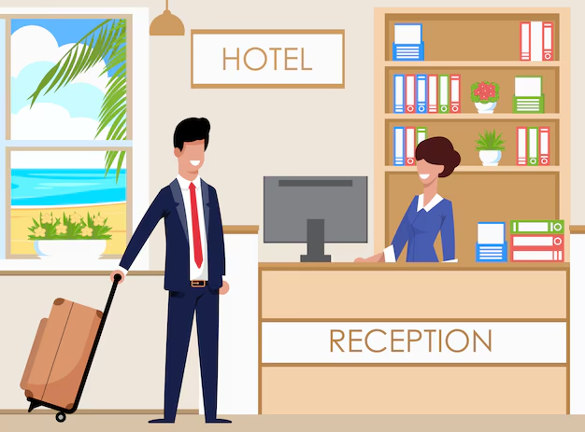
Hotel Reservation Analysis using
SQL
Presented By Raj Gudhka

Slide 2
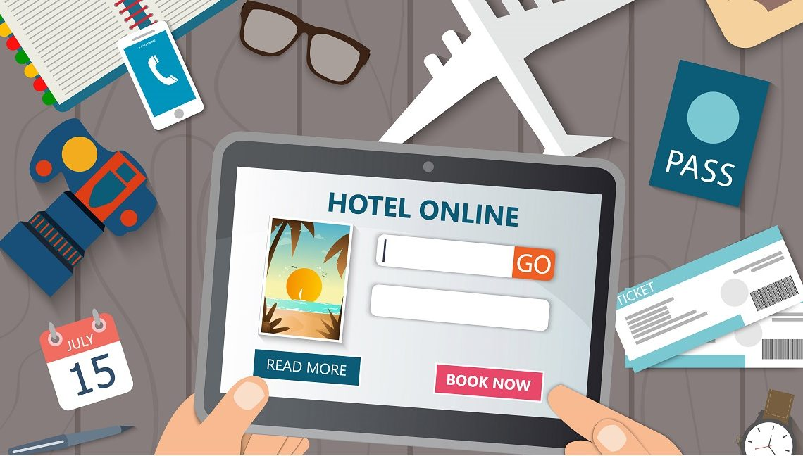
Project Overview
The hotel industry relies on data to make informed decisions and enhance the overall guest experience. In this project, we delve into a comprehensive hotel reservation dataset to extract meaningful insights. Our goal is to uncover guest preferences, Identify booking trends and discover key factors influencing how the hotel operates.

Slide 3

Objective
Our objective is to leverage SQL for in-depth exploration and analysis of the dataset. By addressing specific queries related to the dataset , our goal is to reveal patterns that will guide strategic decisions and optimize the overall performance of the hotel.
Tools Used:-

Slide 4
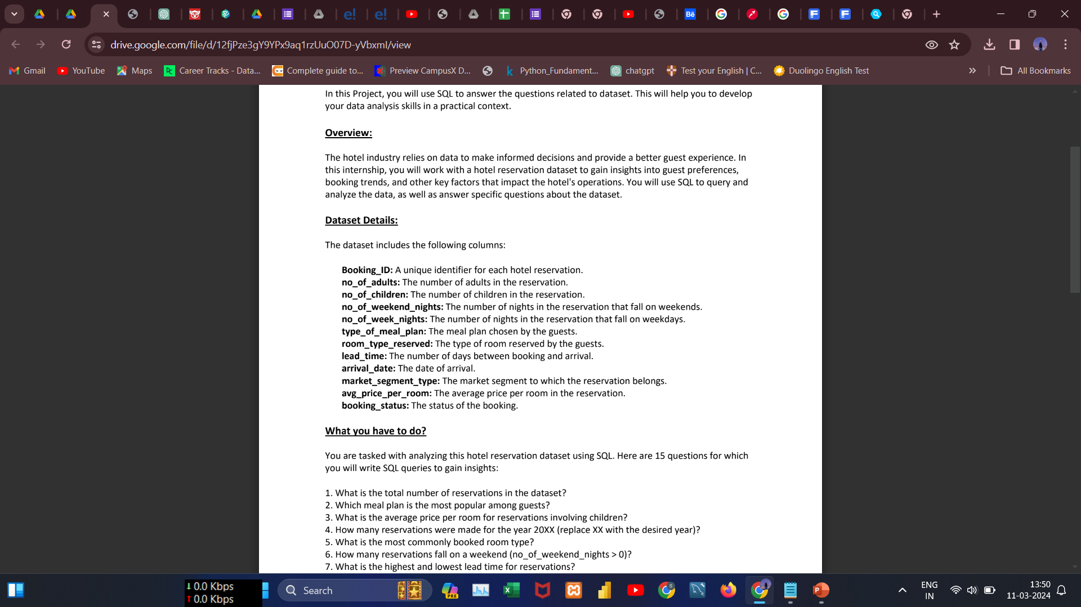
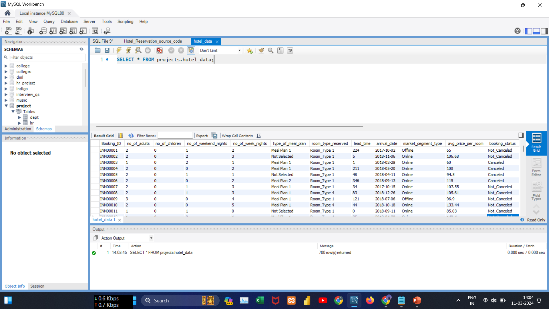
Dataset Overview

Slide 5
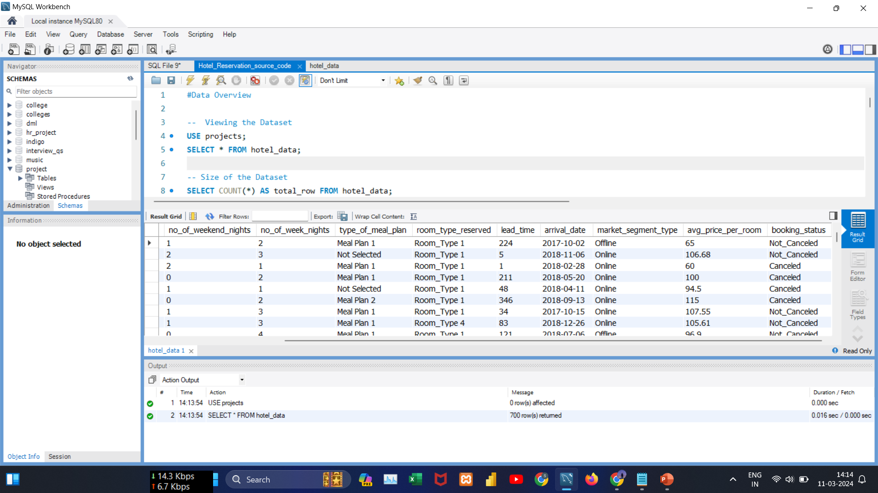
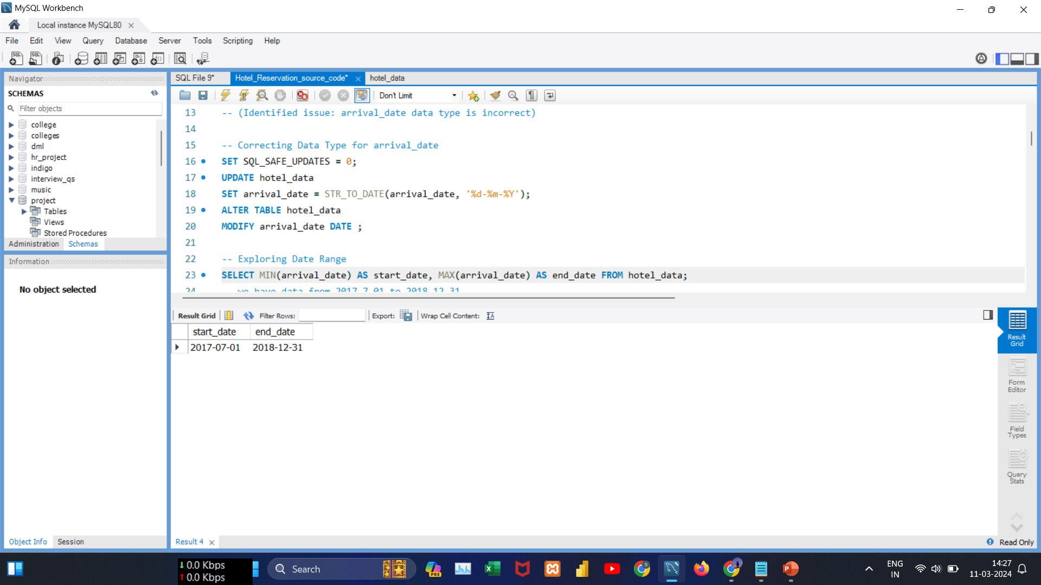
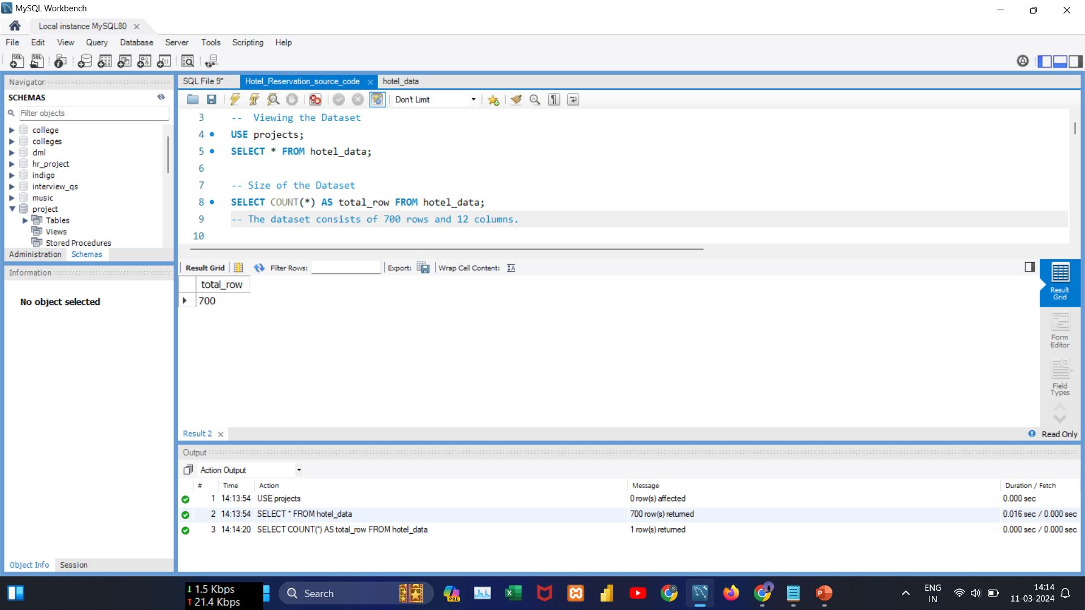
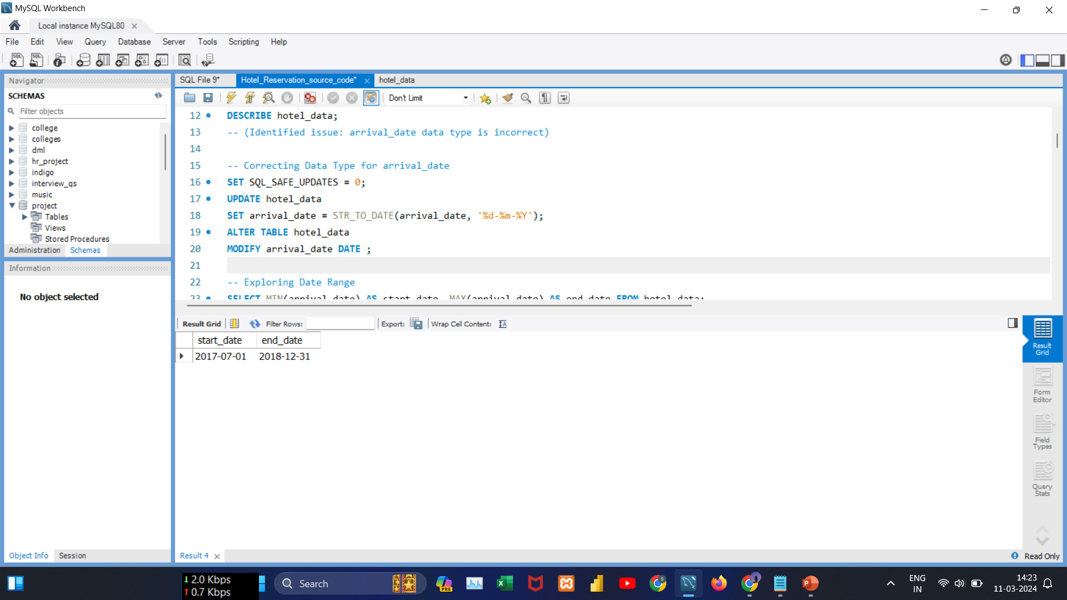
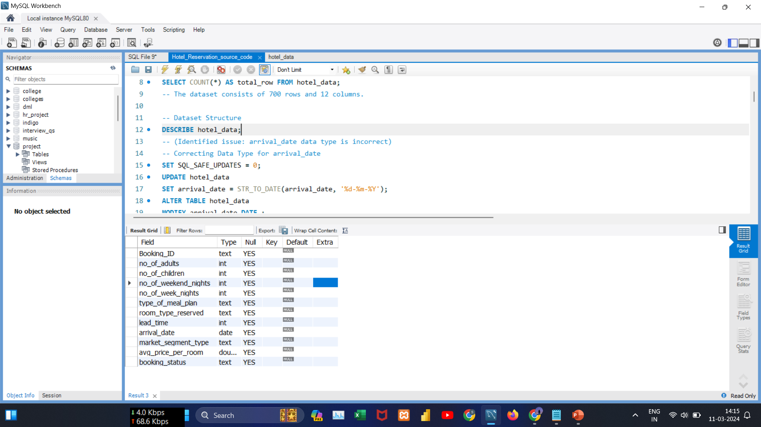
Data Exploration with SQL
Insights:
The dataset consists of 700 rows and 12 columns, spanning from 2017 to 2018.

Slide 6
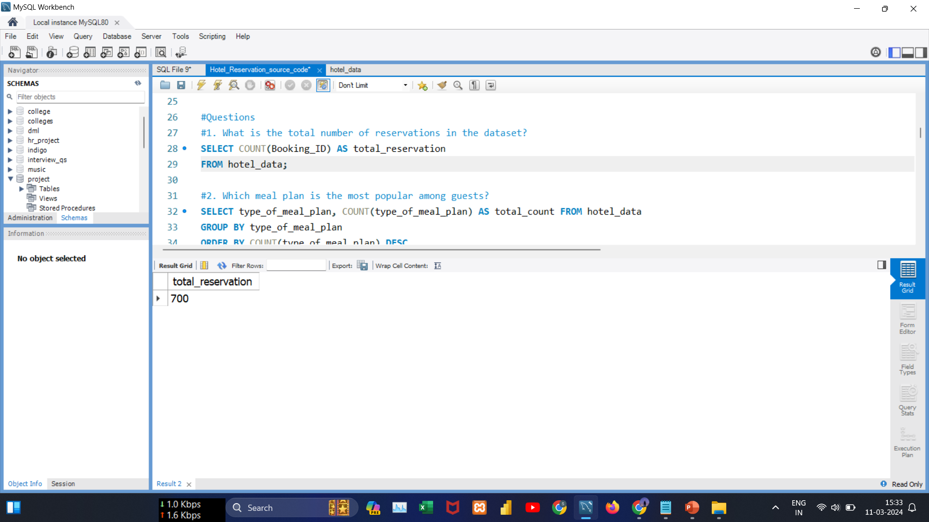
Data Analysis Queries
#Query1 :
What is the total number of reservations in the dataset?
Insights:
There are 700 reservations in the dataset.

Slide 7
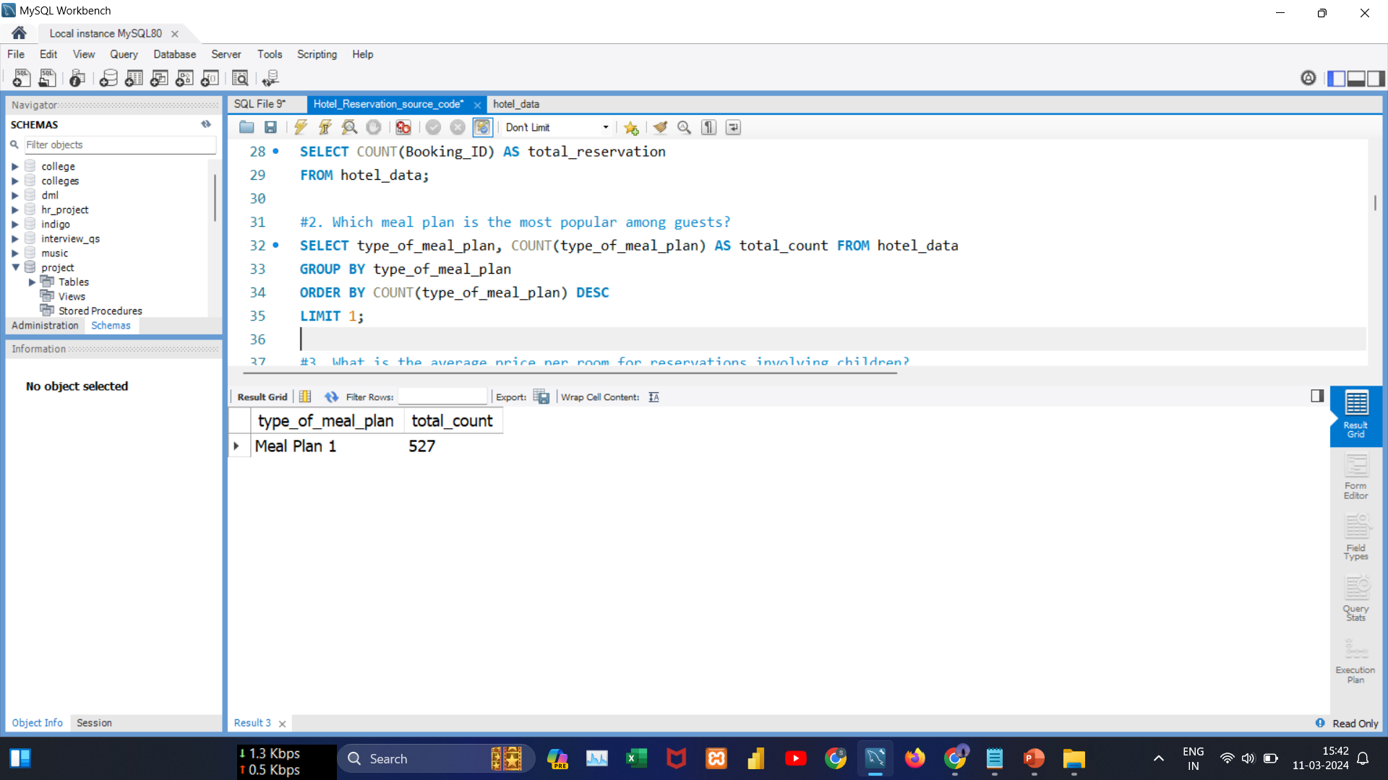
Data Analysis Queries
#Query2 :
Which meal plan is the most popular among guests?
Insights:
Meal Plan 1 stands out as the most popular choice among guests.

Slide 8
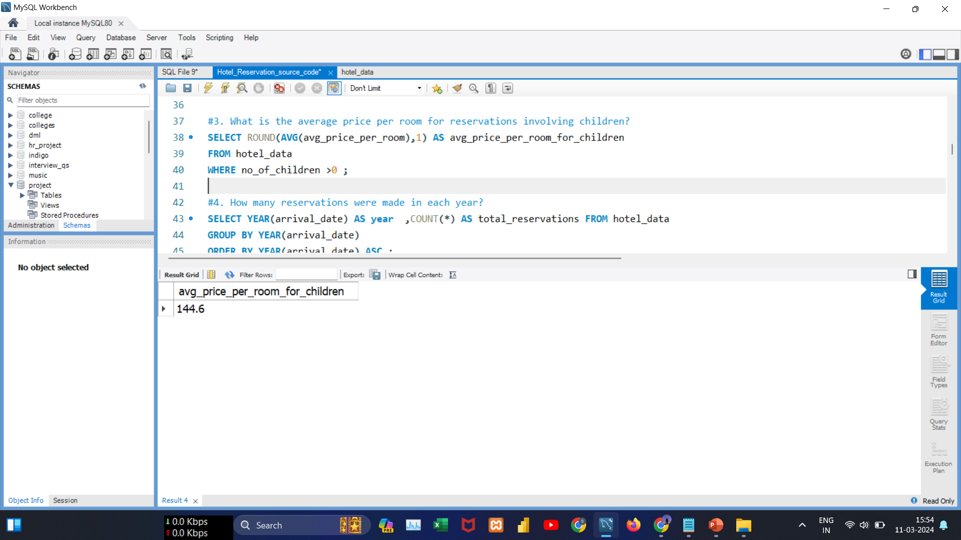
Data Analysis Queries
#Query3:
What is the average price per room for reservations involving children?
Insights:
Reservations involving children have an average room price of 144.6.

Slide 9
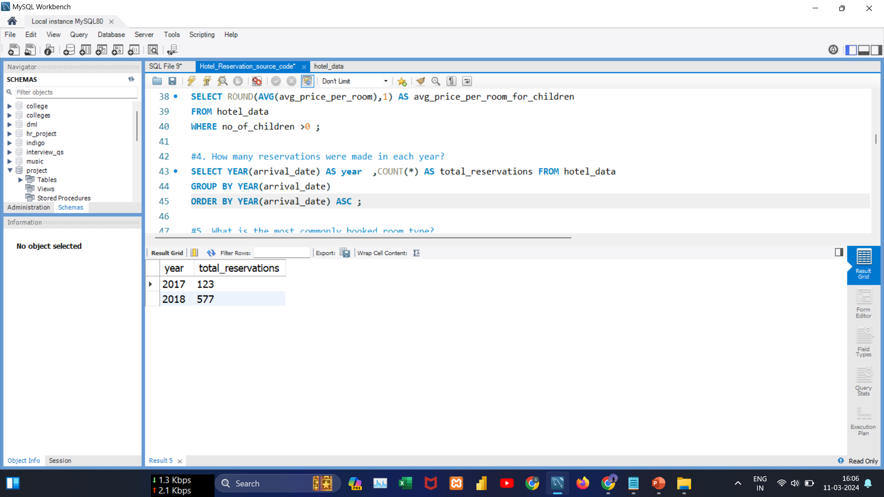
Data Analysis Queries
#Query4:
How many reservations were made in each year?
Insights:
In 2017, there were 123 reservations. Subsequently, in 2018, the reservations experienced a significant increase, indicating positive growth.

Slide 10
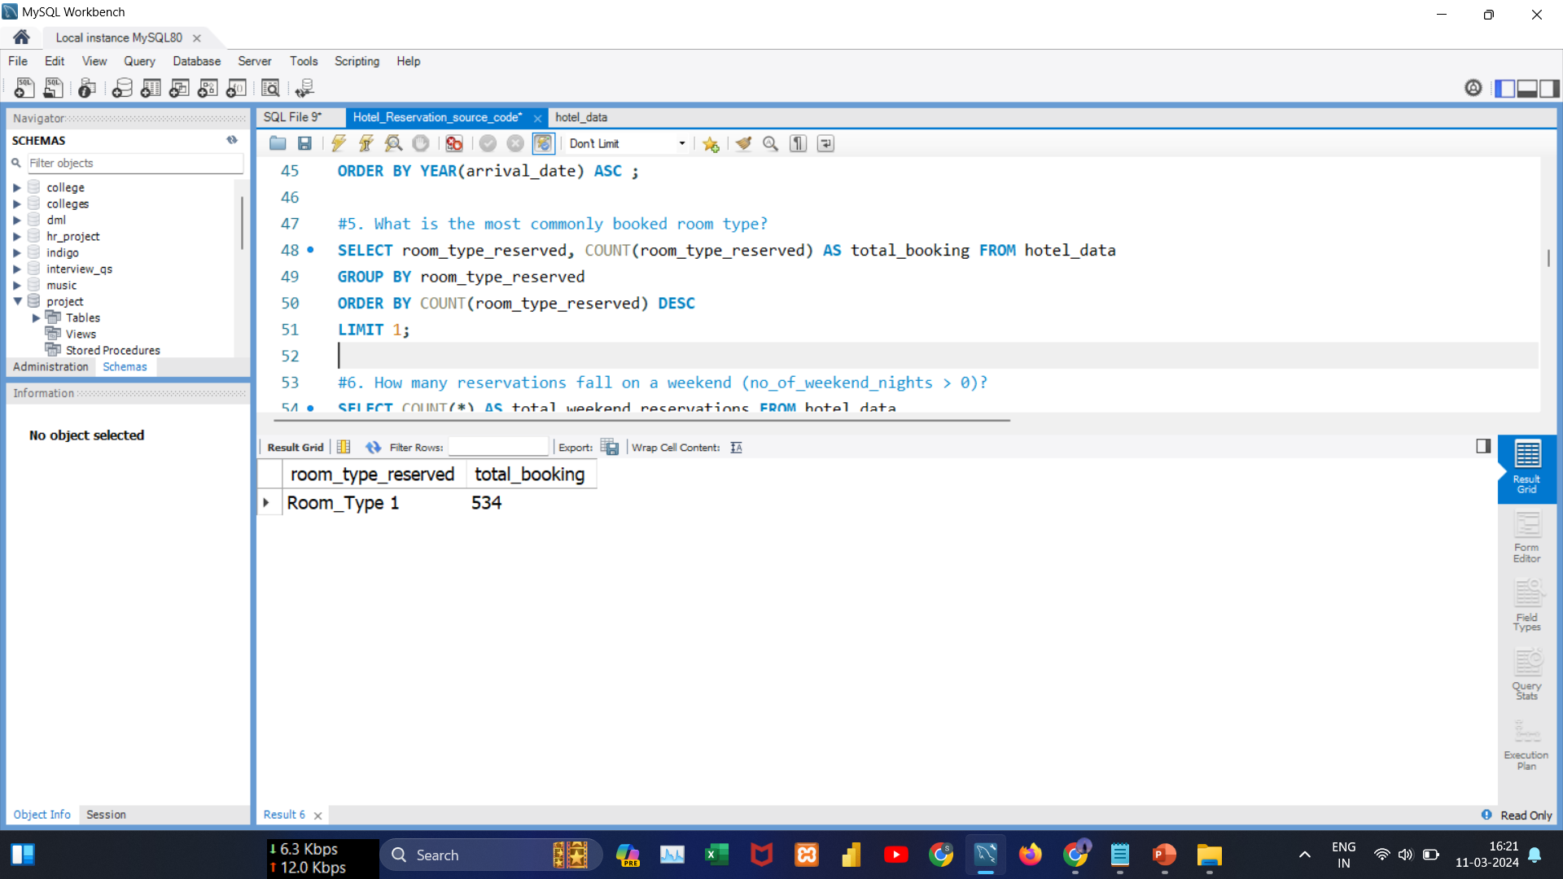
Data Analysis Queries
#Query5:
What is the most commonly booked room type?
Insights: Room Type 1 is the guests' top choice for bookings.

Slide 11
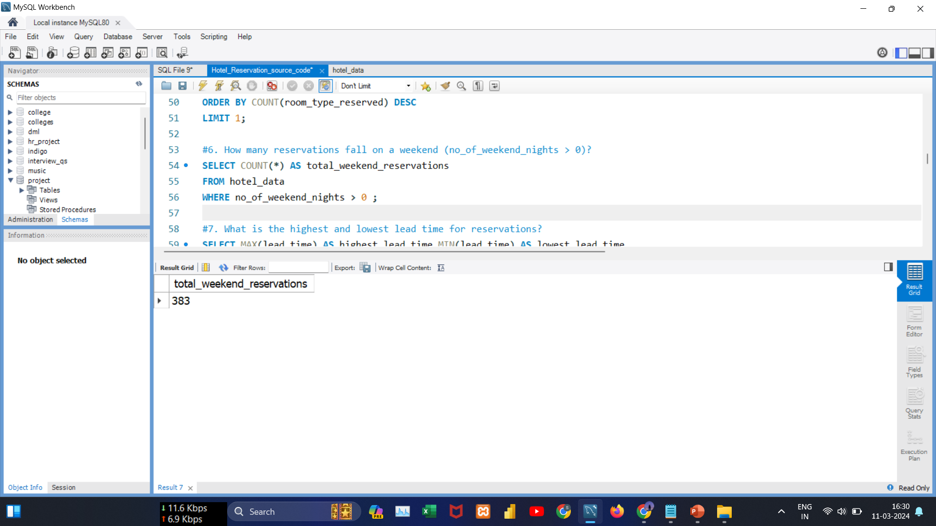
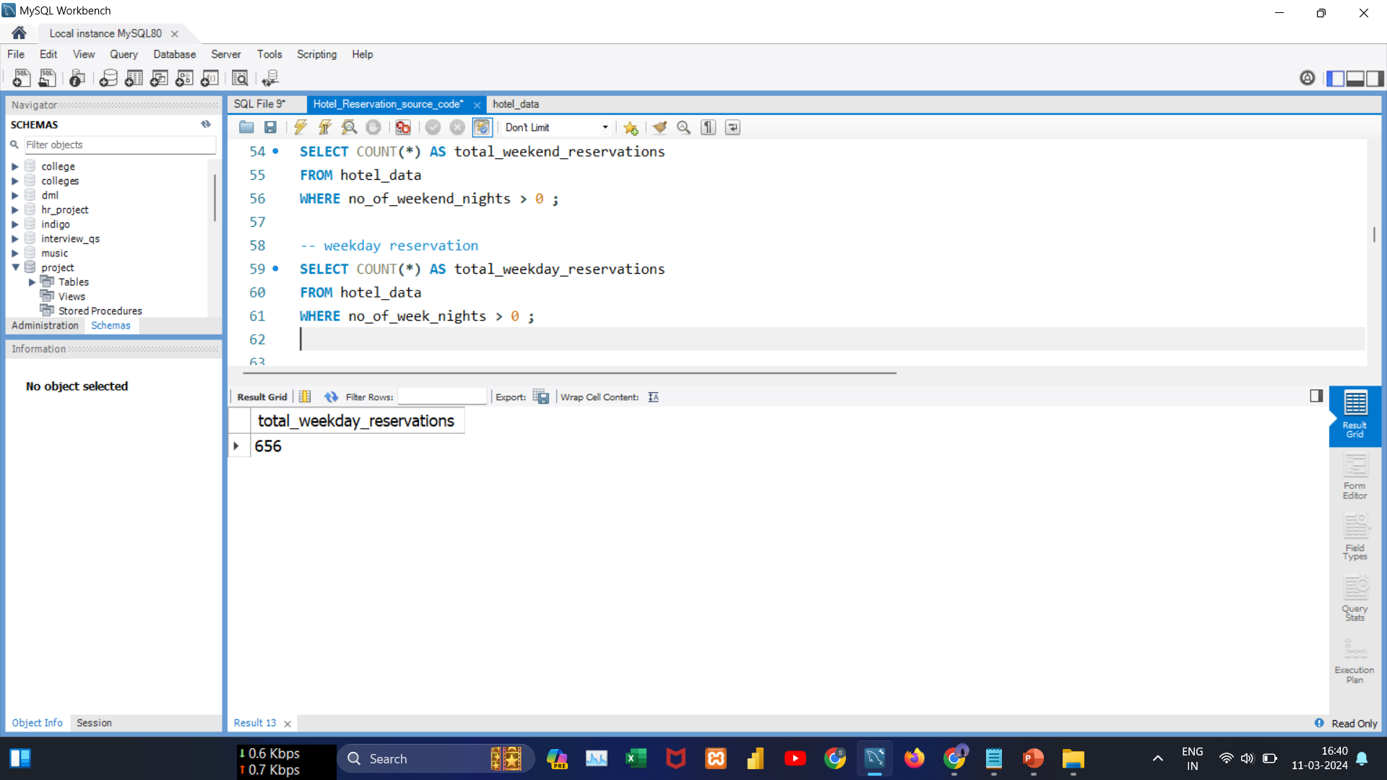
Data Analysis Queries
#Query6:
How do guest reservations vary between weekend and weekday nights?
Insights: The higher number of reservations for weekday nights (656) compared to weekend nights (383) suggests a guest preference for staying during weekdays.
This preference indicates an opportunity for the hotel to optimize offerings during weekdays.

Slide 12
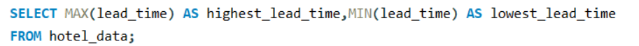
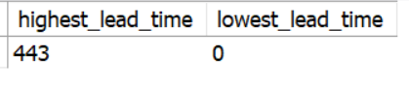
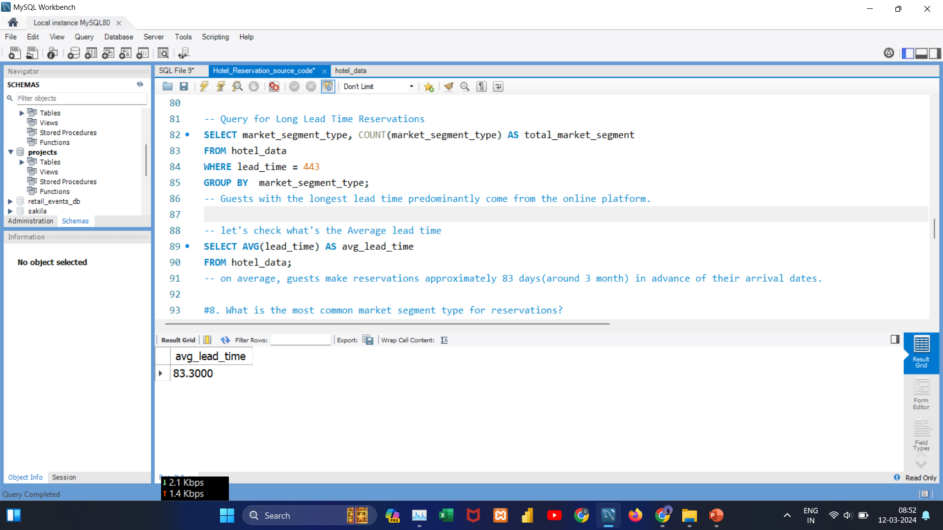
Data Analysis Queries
#Query7:
What is the highest, lowest, and average lead time for reservations?
Insights: The range of lead times, from 0 to 443 days, suggests diverse booking behaviors among guests. Some prefer last-minute reservations, while others plan well in advance. On average, reservations have a lead time of 83.30 days.

Slide 13
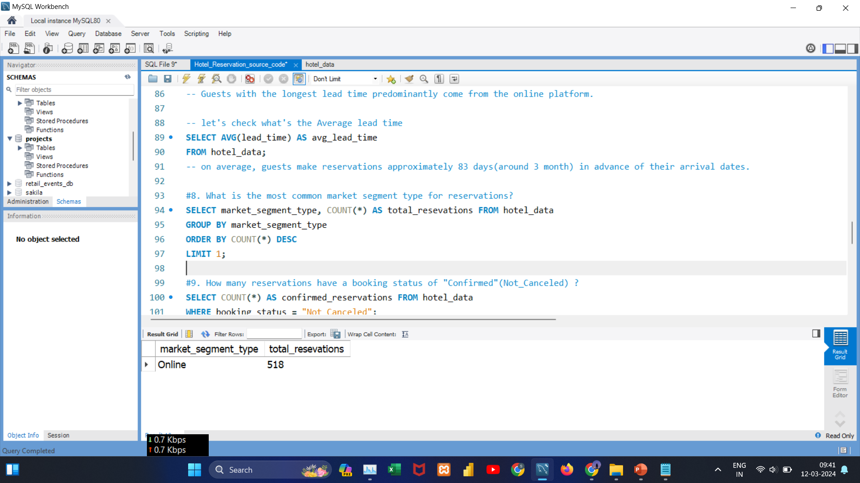
Data Analysis Queries
#Query8:
What is the most common market segment type for reservations?
Insights:
The online market segment is the most popular choice among guests , showcasing a clear preference for online reservations.

Slide 14
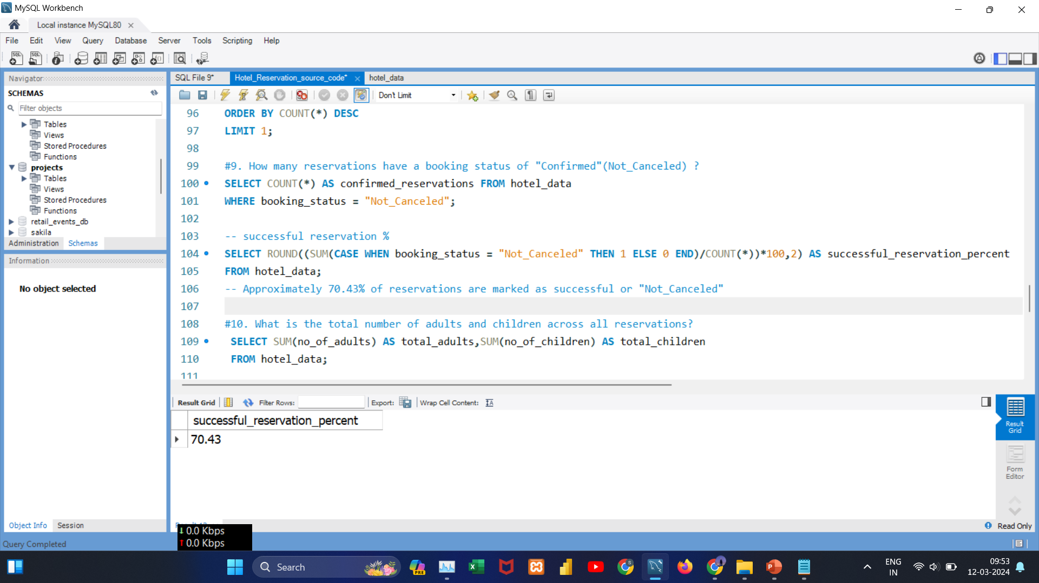

Data Analysis Queries
#Query9:
What is the total number of confirmed reservations, and what percentage of reservations have a "Confirmed" booking status?
Insights:
Out of 700 reservations, 493 are confirmed, indicating a success rate of approximately 70.43%. This suggests a high rate of successful reservations.

Slide 15
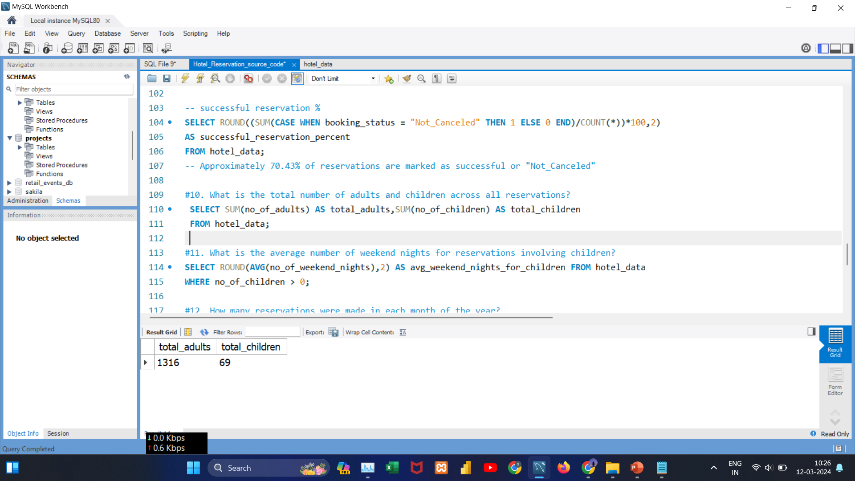
Data Analysis Queries
#Query10:
What is the total number of adults and children across all reservations?
Insights:
The majority of reservations, totaling 1,316, involve adult guests, while a smaller number, 69, include children. This highlights the hotel's primary appeal to adult.

Slide 16
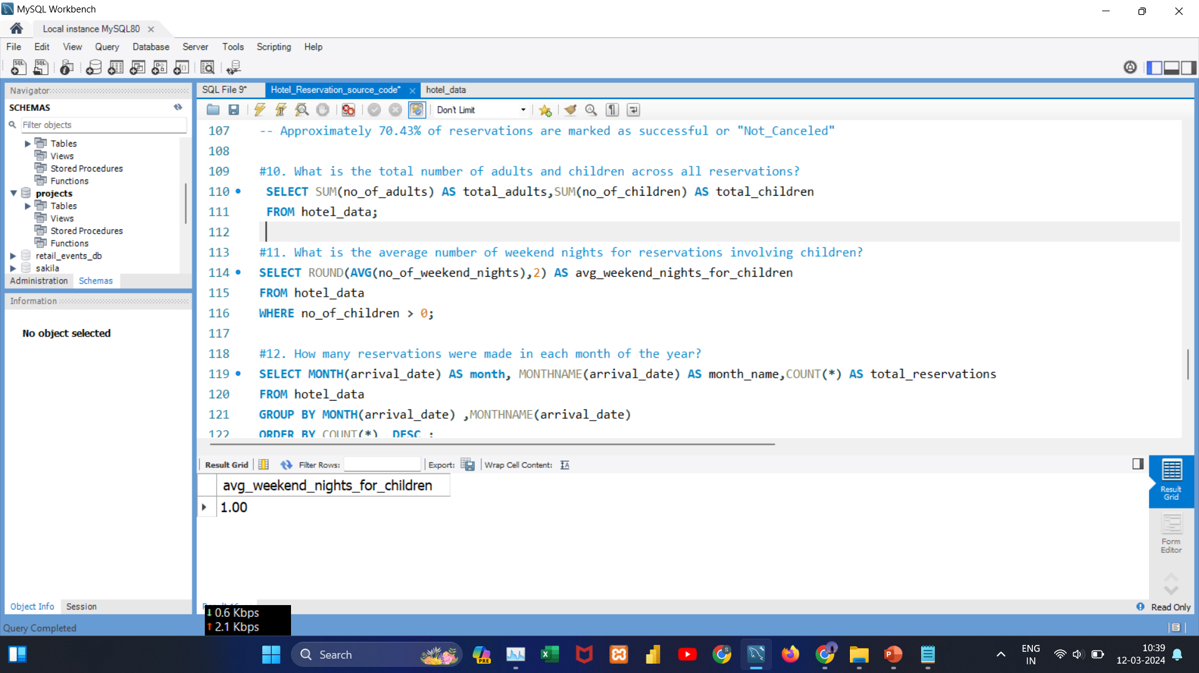
Data Analysis Queries
#Query11:
What is the average number of weekend nights for reservations involving children?
Insights:
On average, reservations with children involve a one-night stay on weekends, highlighting a preference for weekend stays, particularly suitable for families.

Slide 17
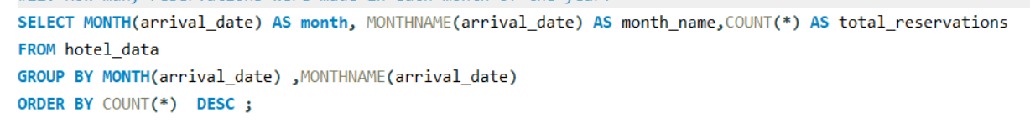
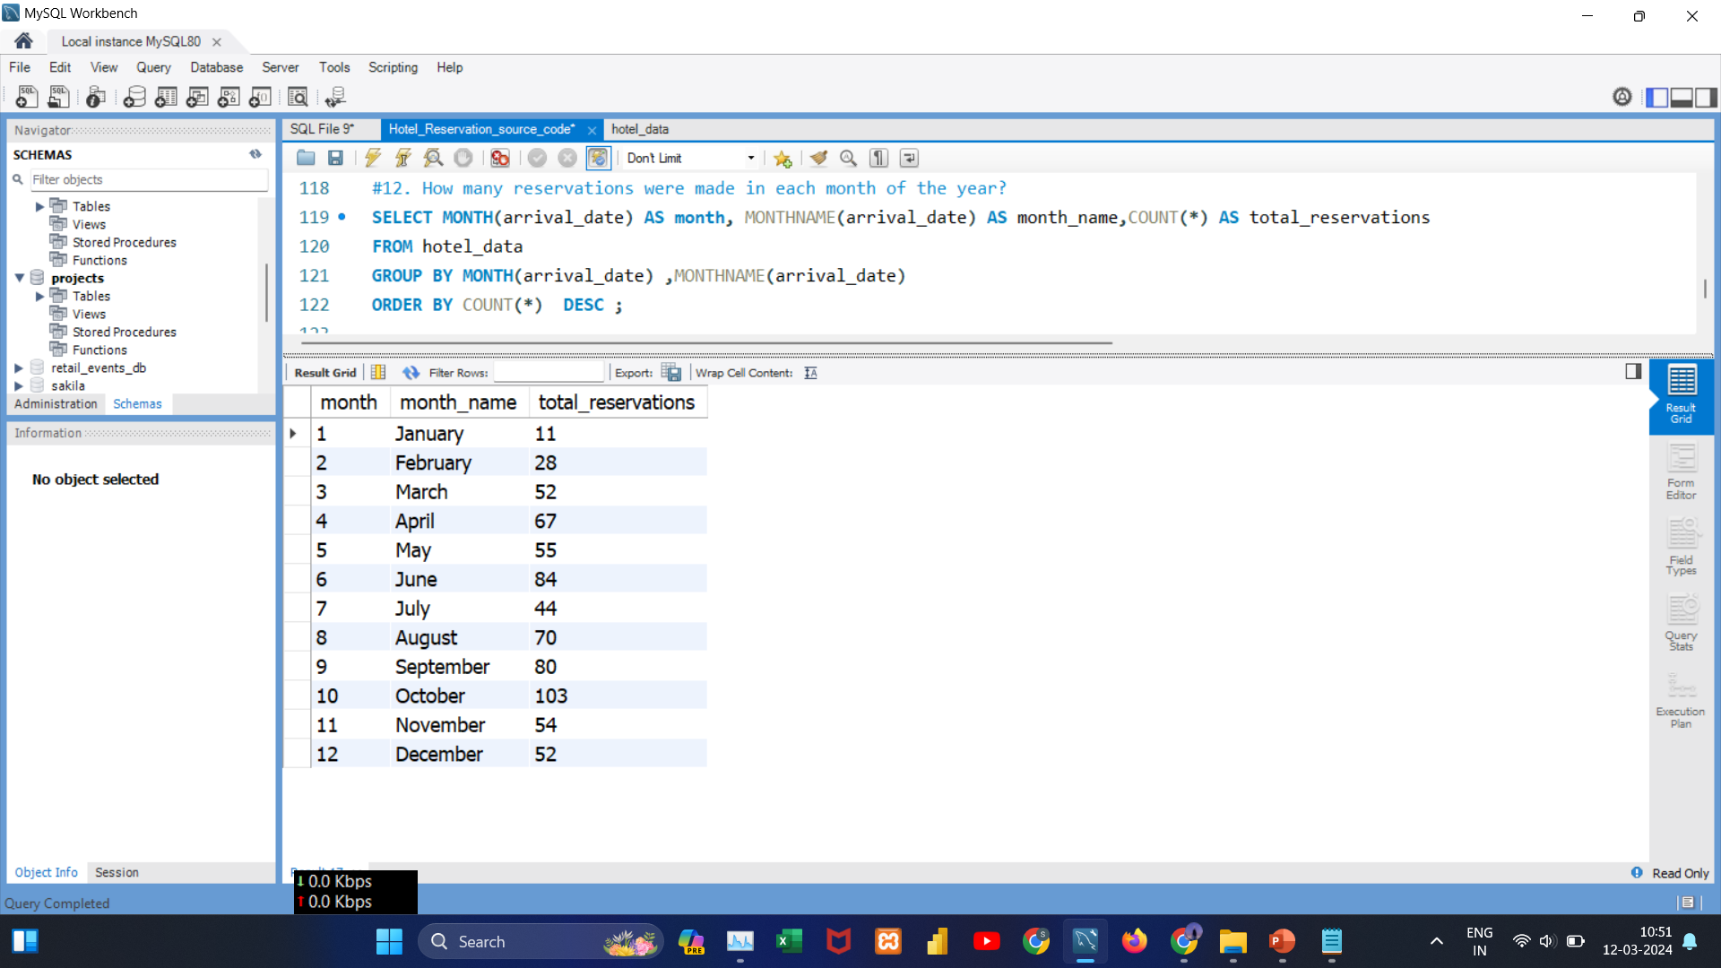
Data Analysis Queries
#Query12:
How many reservations were made in each month of the year?
Insights:
October stands out as the peak reservation month followed by June and September . In contrast, January records the lowest number of reservations, indicating a quieter period.

Slide 18
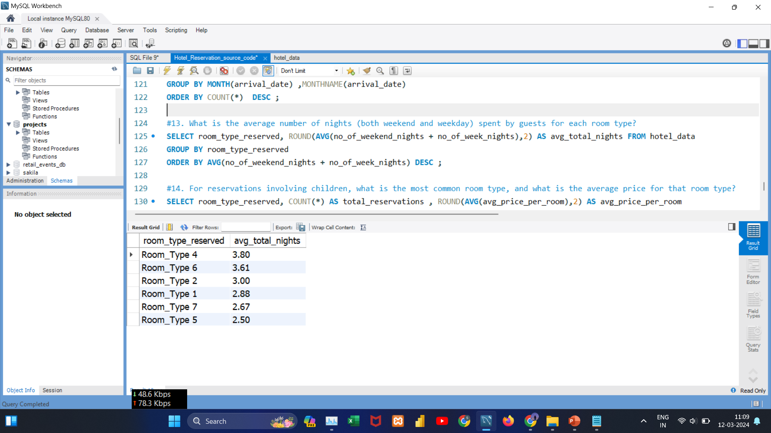
Data Analysis Queries
#Query13:
What is the average number of nights (both weekend and weekday) spent by guests for each room type?
Insights:
Guests staying in Room Type 4 tend to spend the most nights on average (3.80), while those in Room Type 5 have the lowest average stay duration (2.50).

Slide 19
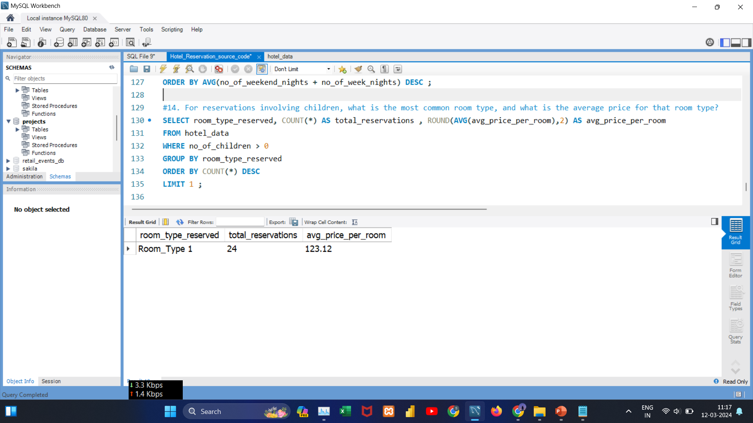
Data Analysis Queries
#Query14:
For reservations involving children, what is the most common room type, and what is the average price for that room type?
Insights:
For reservations involving children, Room Type 1 is the preferred choice, with an average room price of 123.12.

Slide 20
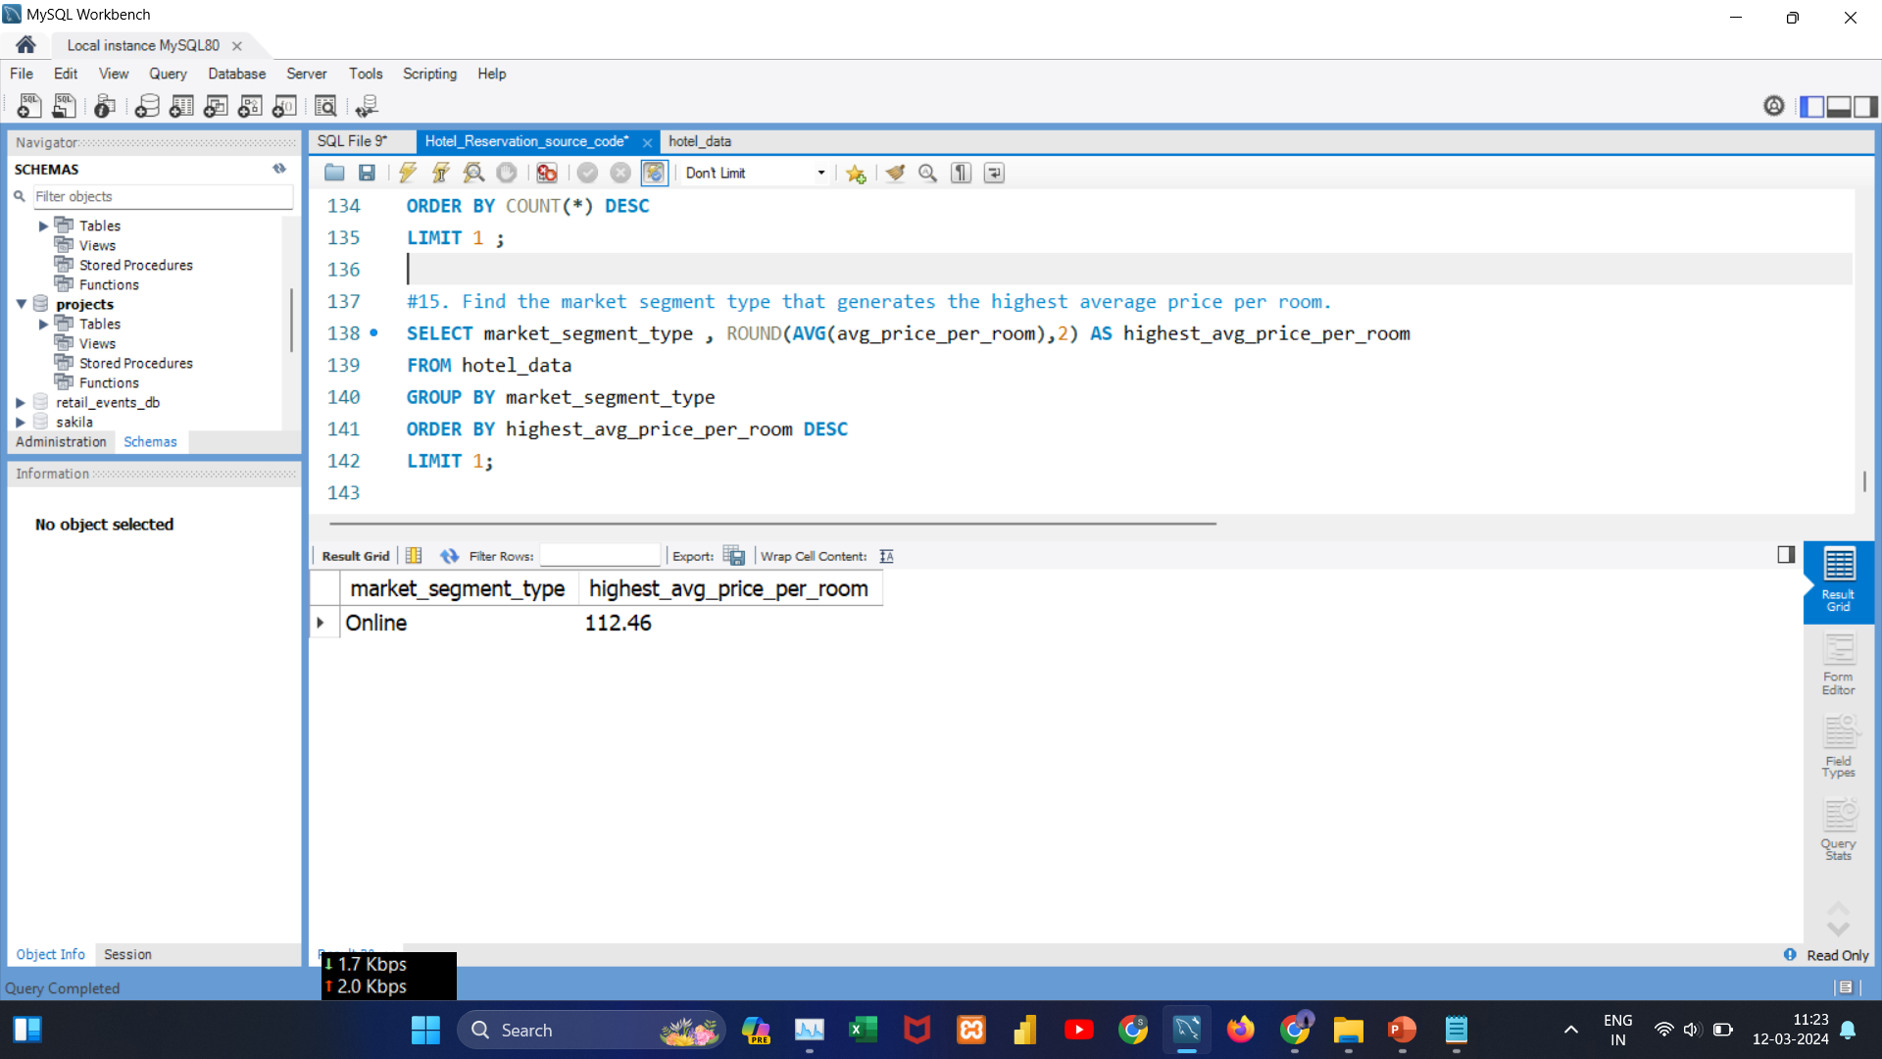
Data Analysis Queries
#Query15:
Find the market segment type that generates the highest average price per room?
Insights:
Online bookings generate the highest average room price, reaching 112.46.

Slide 21
Key Questions
1. What is the total number of reservations in the dataset?
2. Which meal plan is the most popular among guests?
3. What is the average price per room for reservations involving children?
4. How many reservations were made in each year?
5. What is the most commonly booked room type?
6. How many reservations fall on a weekend (no_of_weekend_nights > 0)?
7. What is the highest, lowest, and average lead time for reservations?
8.What is the most common market segment type for reservations?
9.What is the total number of confirmed reservations, and what percentage of reservations have a "Confirmed" booking status?
10.What is the total number of adults and children across all reservations?
11.What is the average number of weekend nights for reservations involving children?
12.How many reservations were made in each month of the year?
13.What is the average number of nights (both weekend and weekday) spent by guests for each room type?
14.For reservations involving children, what is the most common room type, and what is the average price for that room type?
15.Find the market segment type that generates the highest average price per room?

Slide 22
Overall Insights:-
There are 700 reservations in the dataset.
Meal Plan 1 stands out as the most popular choice among guests.
Reservations involving children have an average room price of 144.6.
In 2017, there were 123 reservations. Subsequently, in 2018, there was a notable increase in reservations, indicating positive growth.
Room Type 1 is the preferred choice for bookings.
Guests show a preference for weekday night stays (656) over weekends (383).
Diverse booking behaviors with lead times ranging from 0 to 443 days. On average, guests make reservations approximately 83 days (around 3 months) ahead of their arrival dates.
Urgent last-minute bookings (same-day arrivals) are most common among guests from online, corporate, and offline market segments.
Guests with the longest lead time predominantly come from the online platform.
Online market segment is the most popular choice.
493 out of 700 reservations are confirmed, indicating a 70.43% success rate.
Majority of reservations (1,316) involve adult guests.
Reservations with children suggest a preference for one-night stays on weekends.
October is the peak reservation month, while January records the lowest reservations.
Room Type 4 guests prefer longer night stays (average of 3.80 nights), while Room Type 5 guests opt for shorter durations (average of 2.50 nights).
For reservations involving children, Room Type 1 is the preferred choice, with an average room price of 123.12.
Online bookings generate the highest average room price, reaching 112.46.

Slide 23
Recommendations
Implement targeted promotions for Room Type 1 to capitalize on its popularity.
Tailor marketing strategies to attract online bookings, the most prevalent segment.
Explore partnerships or promotions to boost reservations during quieter months like January.
Enhance confirmation and booking processes to maintain the high success rate of reservations.
Introduce special packages and incentives to attract guests seeking longer stays, especially those choosing Room Type 4.
Focus on enhancing services and promotions during weekdays to meet the strong demand for reservations on weekday nights (656), creating an opportunity to attract a larger number of guests.
Offer special discounts or promotions for guests making last-minute bookings. This strategy not only attracts more bookings but also minimizes the chance of cancellations.
Improve the hotel experience for families by introducing special amenities and activities. Create attractive packages for one-night stays on weekends, designed for families looking for a weekend getaway.
Continue monitoring and adapting strategies based on changing guest preferences and market trends.

Slide 24

Thank You

